Slide 1
Measuring and Controlling Body Temperature with XBee.

Slide 2
Problem Statement
Human body temperature can be measured in several places, including the ear, finger, mouth and anus. There are various ways to measure body temperature , including using a clinical thermometer, heat-sensitive strips, digital probes or thermal imaging cameras.
Heating or cooling certain parts of your body-such as applying a warm towel to your forehead if you feel chilly-can help maintain your perceived thermal comfort. Based on this concept can we design :
A) a device which can control our body temperature
B) and a device which can replace the conventional thermometer and pulse oximeter
Can we use the principles of electronics in bio-medical technology ?

Slide 3
Solution.
As ICT engineers we can make a Temperature measuring and Pulse rate monitoring device which can not only measure our temperature which can also gather data, and data can be used by doctors.
We also want to send out the data collected to specified doctors and hospitals using XBee via text message.
Therefore, Our study aims to create a working prototype of the “Pulse Rate and Body Temperature Monitoring Device with XBee”

Slide 4
How body maintains Temperature?
How do body gains heat when it is cool?
Heat can be gained by respiration, shivering, exercise or by reducing the blood flow to the skin. Clothing also helps to retain heat.
How do body loses heat when it is too hot?
If we get too hot, heat can be lost by reducing the blood flow to the skin or by sweating. Sweating increases heat loss by evaporation.

Slide 5
Detailed Analysis.
Following is the Internal mechanism through which body controls the temperature:
The body’s temperature is monitored by a part of the brain called the hypothalamus. If you are too hot or too cold, it sends nerve impulses to the skin.
The blood vessels supplying blood to the skin can dilate or swell. This is called vasodilation. It causes more heat to be carried by the blood to the skin, where it can be lost to the surroundings.
Blood vessels can shrink down again. This is called vasoconstriction. It reduces heat loss from the skin once the body’s temperature has returned to normal.
This sort of control is a ‘negative feedback mechanism’. The body’s internal environment is kept almost constant by causing cooling if it gets too hot, and warming if it gets too cold.

Slide 6
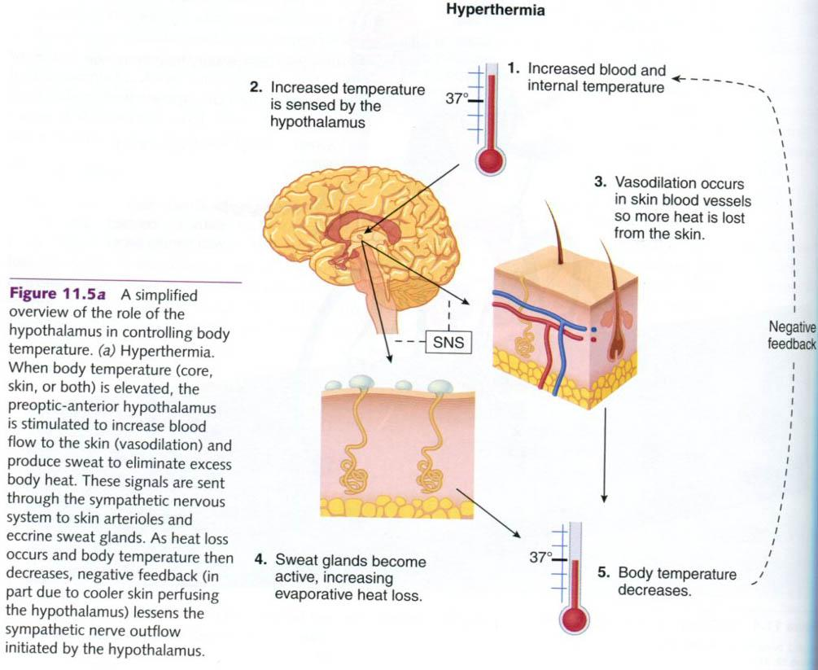
http://s1251.photobucket.com/user/vladimirzec/media/Fiziologija/img384.jpg.html

Slide 7
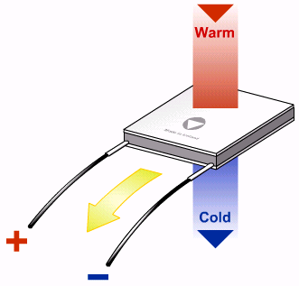
Peltier Effect
Peltier effect was invented in 19th century and peltier devices are made using p and n type semiconductors.
The Peltier effect occurs whenever electrical current flows through two dissimilar conductors. Depending on the direction of current flow, the junction of the two conductors will either absorb or release heat.
The cooling side should be placed in contact with the surface whose temperature you want to control. Other side should be connected to the heat sink which will absorb heat from peltier device.

Slide 8
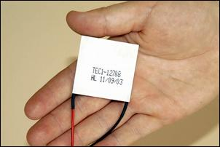
Why to use Peltier effect?
Thermoelectric technology are strong in products which demand both heating and cooling in the face of a changing operating environment.
Technology really shines, is in making it feasible to do very small cooling jobs.
Thermoelectric system components can be mounted in any physical orientation and still function properly.
These devices do not require evaporative chemicals which may be harmful to the environment.

Slide 9
Temperature Variations in Malaria
The most common symptom of malaria is fever, when the body temperature is high. The fever from malaria usually comes very suddenly.
The attack begins with fever, with the temperature rising as high as 40ºC and falling again over a period of several hours.
When the temperature drops, the patient often sweats profusely and feels much better. Then the same day, or one to two days later, further attacks occur with feeling generally unwell, high temperature and so on.

Slide 10
Temperature Variations in Heat Stroke.
Heat stroke is the most severe form of heat-related illness, and it can sometimes lead to death or permanent disability.
The body's temperature rises rapidly in excess of 105 F (40.5 C), leading to damage to the brain and other vital organs.

Slide 11
Temperature Variations in Heat Exhaustion.
Heat exhaustion is the body's response to an excessive loss of water and salt contained in sweat as a result of engaging in physical activity (work or exercising) in a hot environment.
The body temperature may be normal or mildly elevated, but not above 104 F (40 C). It generally occurs in individuals who are not accustomed to working or exercising in the heat.

Slide 12
Pulse rate Monitoring
In pulse rate Monitoring device, we are using IR transmitter and receiver to transmit and receiver the pulse rate of human body through the finger.
We can see the output through the LED and also through the serial monitor of the arduino software.
Output of the circuit is not very much accurate because of the noise which has the frequency between 50Hz to 60Hz.

Slide 13
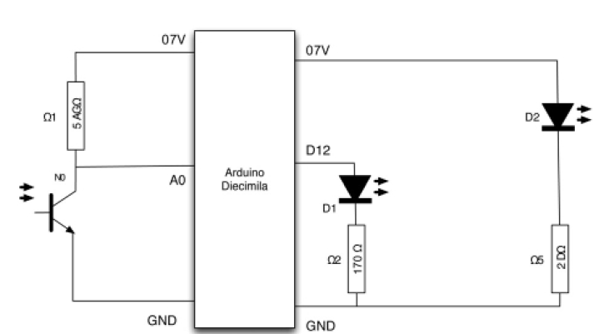
Pulse Rate Monitoring Circuit

Slide 14
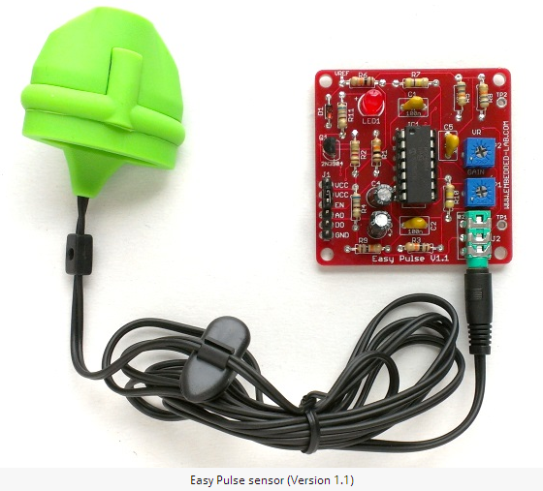
Pulse Sensor
The Pulse sensor allows you to measure the pulse rate from fingertip using the transmission mode PPG (Photoplethysmography).
IR LED that illuminates the finger from one side.
A photodetector detects the transmitted light through the finger.
It filters out the noise from the PPG signal and amplifies signal.

Slide 15
Temperature Monitoring
For temperature monitoring, we are using Arduino board as a micro-controller and LM35 as temperature sensor to monitor the temperature of the body.
Then, we will analyse the data and if the temperature is above or below the specified value then we will send the warning message through zigbee protocol to the doctors.
We are using 5 Volt power supply.
We are converting the analog input values to Centigrade value by following sets of formulas.

Slide 16
Temperature Monitoring
The formula for converting the analog reading to volts for 5 volts supply is given by:
1) Voltage at pin in milliVolts = (reading from ADC) * (5000/1024)
For 3.3 Volts of power supply, formula is given by:
2)Voltage at pin in milliVolts = (reading from ADC) * (3300/1024)
To convert from milliVolts to Centigrade temperature, the formula is given by:
3)Voltage at pin in milliVolts = (reading from ADC) * (3300/1024)

Slide 17
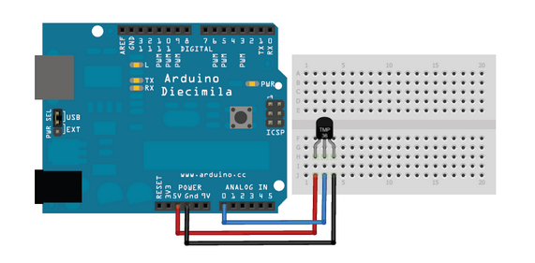
Temperature Monitoring

Slide 18
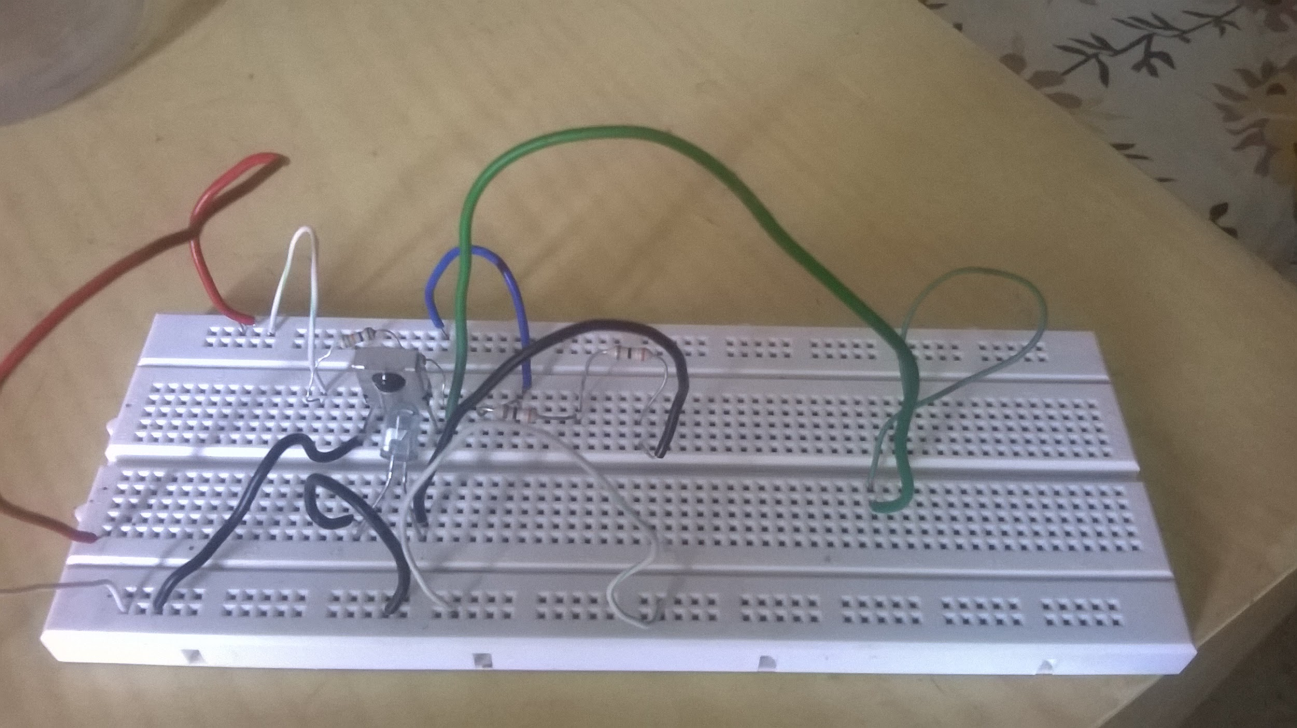
Current Stage.
We are finished with making the Pulse Rate Monitor. Below is the image of our circuit.
We have also made a working video of our circuit.

Slide 19
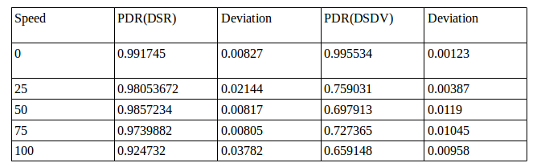
NS2 Simulations

Slide 20
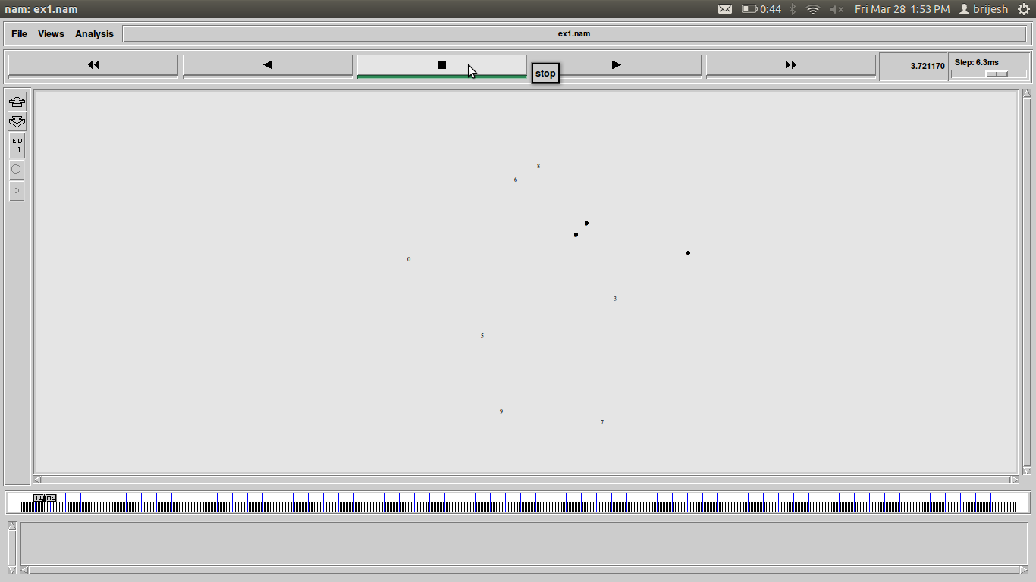
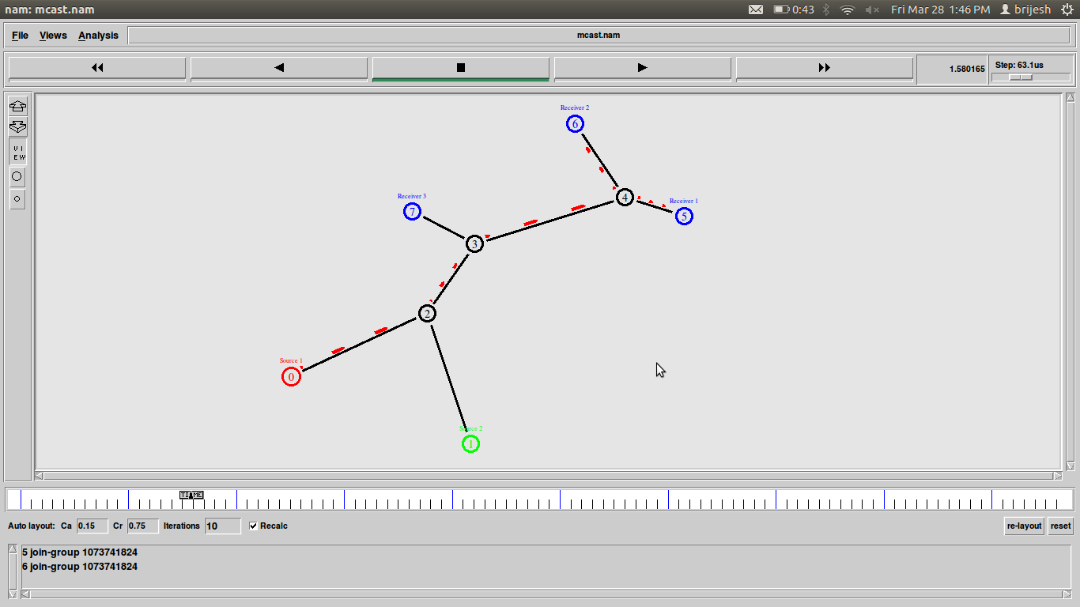
Wired Vs Wireless

Slide 21
Bibliography:
1.http://s1251.photobucket.com/user/vladimirzec/media/Fiziologija/img387.jpg.htm
2. http://www.youtube.com/watch?v=-_qNTSIJL-I
3. http://en.wikipedia.org/wiki/Thermoelectric_effectl
4.http://www.bbc.co.uk/schools/gcsebitesize/science/ocr_gateway/understanding_organisms/staying_in_balancerev2.shtml
5 http://searchnetworking.techtarget.com/definition/Peltier-effect

